Slide 1
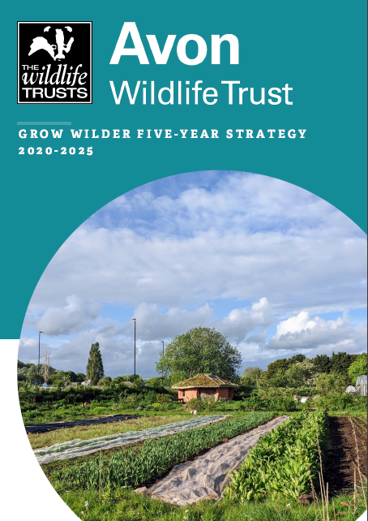
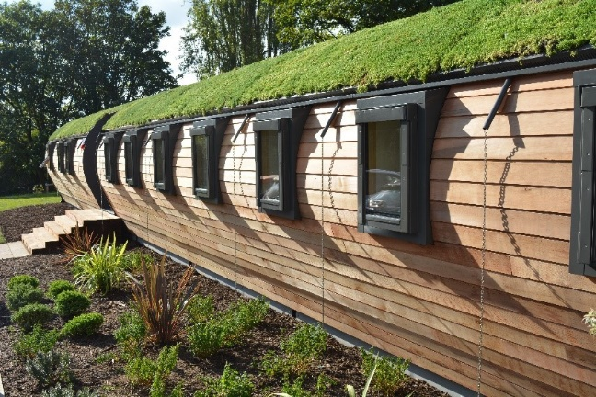
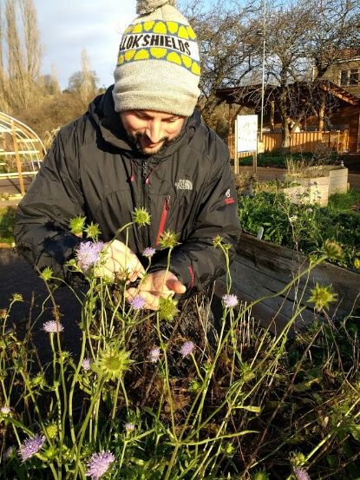
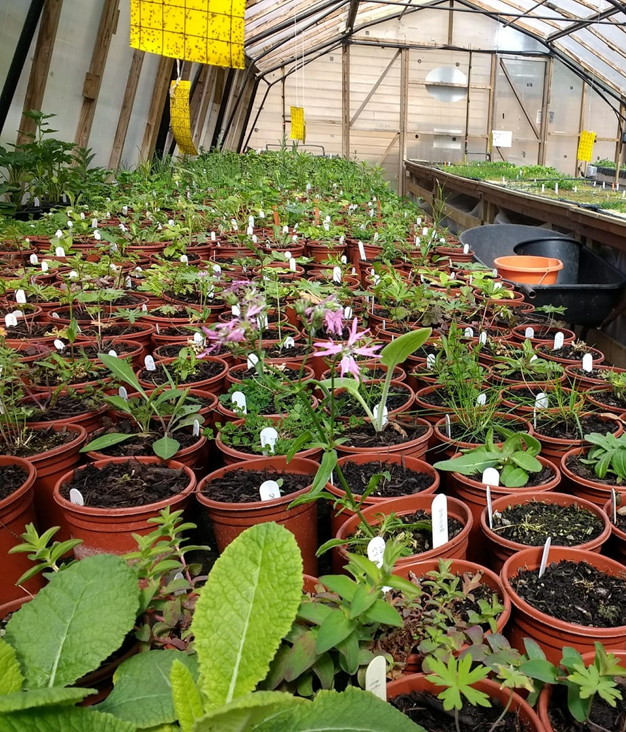
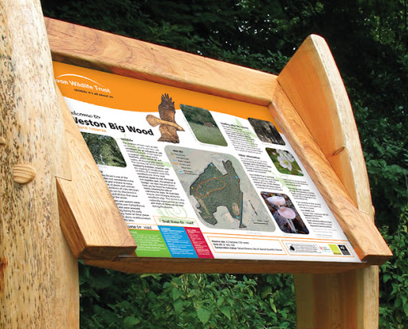
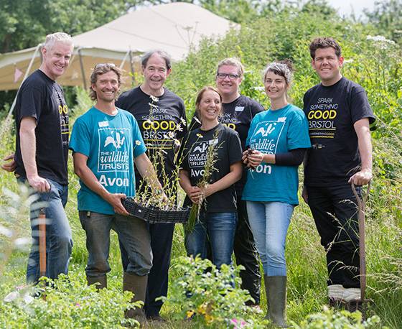
Grow Wilder 5-Year Strategy
“Our mission is to bring about urgent action for the restoration of wildlife by educating, upskilling and empowering people, communities and businesses to bring about positive change through wildlife-friendly gardening and sustainable food growing.”
“Our vision is to establish Grow Wilder as a place to engage and inspire people, communities and businesses to actively support nature’s recovery. Through demonstration, learning and events, Grow Wilder will be a hub from which we will seek to connect people with nature, equipping them with the skills and knowledge to restore and conserve natural habitats of all sizes across the Bristol area and further afield.”
Notes:
Impact Priorities
Educate and Inspire
Help nature’s recovery
Improve social inclusion and diversity
Influence strategy and policy
Enabling Priorities
New Visitor Centre Building
Demonstration and Interpretation
Financial Stability
Volunteers
Strong Partnerships

Slide 2
Current Limitations with Achieving Our Strategy
Inadequate space to deliver education capabilities (1 small indoor classroom, poorly insulated and little natural light)
No focussed area for new visitors to the site
Lack of interpretation and self-learning opportunities
Inadequate toilet facilities
Inadequate kitchen facilities for providing cooked food offerings
Insufficient offerings to give a good visitor experience

Slide 3
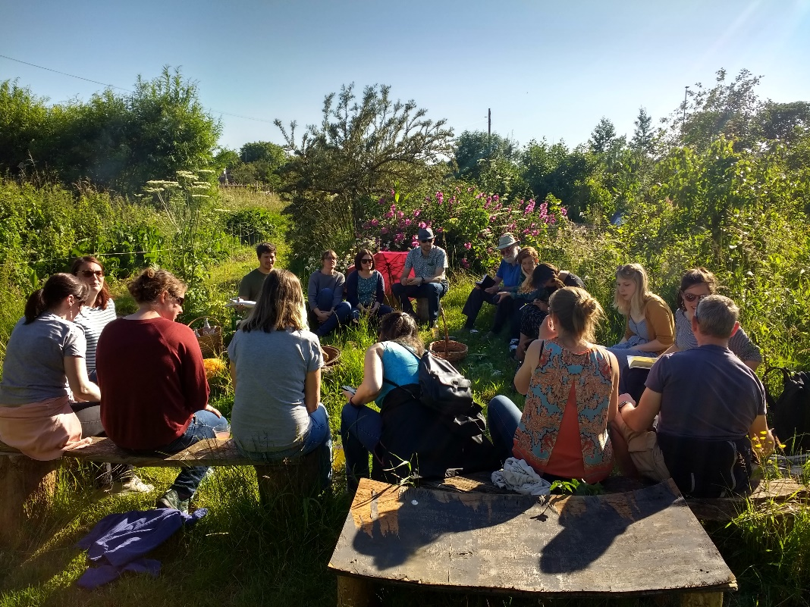
A New Community Amenity
A space for community – the new building will provide a new classroom/meeting space and a café with indoor and outdoor seating.
A hub for sustainable food growing – food growing is the core of the site and we will be increasing that message through new demonstration areas and a new café serving hot food.
Promoting green travel – we are keeping the number of parking spaces the same as we have today. As we attract more visitors we want people to focus on bike, pedestrian and public transport to come to site.
Low carbon building – State of the art eco-build; prepared in sections off site, the build will retain soil through low impact foundations
A living roof and wood cladding – the new building will blend in with the natural feel of the site and be a feature in itself, promoting new innovative ways of building and leading to our aim of a carbon positive site.
Accessible for all – Everyone is welcome to come visit, explore and enjoy the site during open hours.

Slide 4
Benefits of a New Engagement Hub
Feature
Outcome
Benefit
Welcome area
Begin the visitor journey, teach about the site and let visitors get the most out of their visit
More people learning and engaging with the site; actively finding out more about how the site operates and what they can do on site during their visit (trails, wildlife ID, etc.)
Café, serving some food grown on site
Attract more visitors to site. Get people actively interested in local food systems.
More people understand importance of local food systems and change behaviours after seeing food grown, learning about importance of sustainable food growing and then eating that same food in one visit.
Shop
Visitors can buy books, tools or discovery packs. Also, Land Partner produce (veg, crafts etc)
Visitors who have been inspired by GW can take their next steps in food growing and wildlife gardening. Land partners also have a direct way to sell produce to visitors.
New community space
More capacity for education and community activities at Grow Wilder
More people learning how to grow food and help nature recover. More people growing food and helping nature in their own communities. More community usage of site from local area.

Slide 5
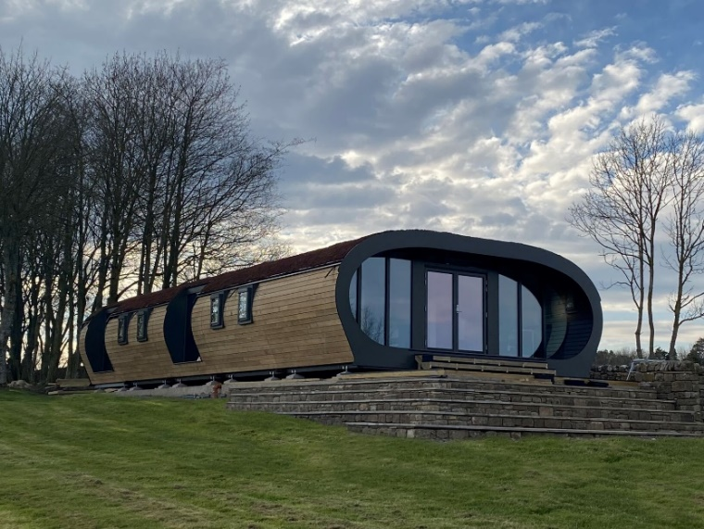
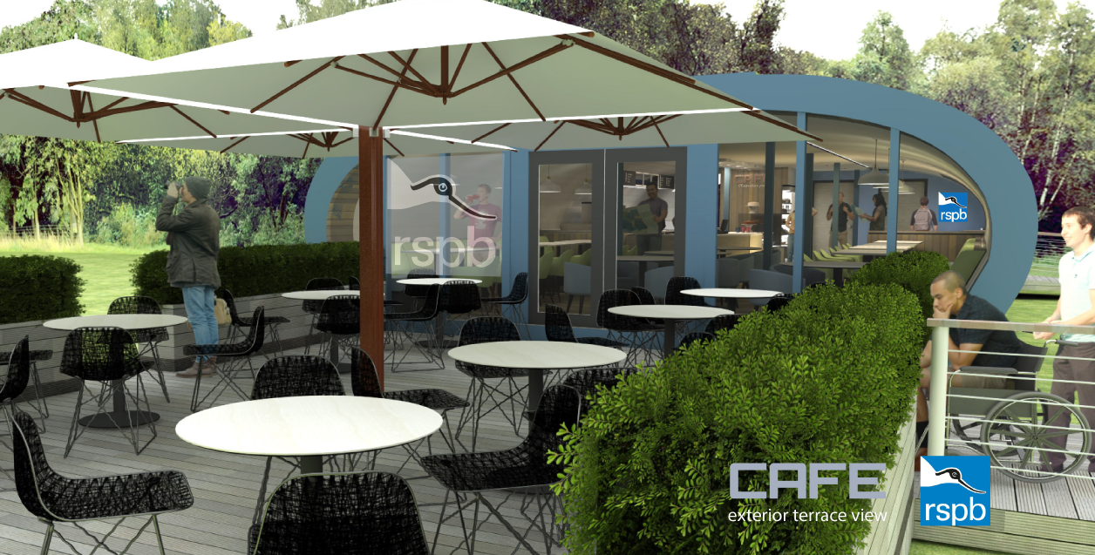
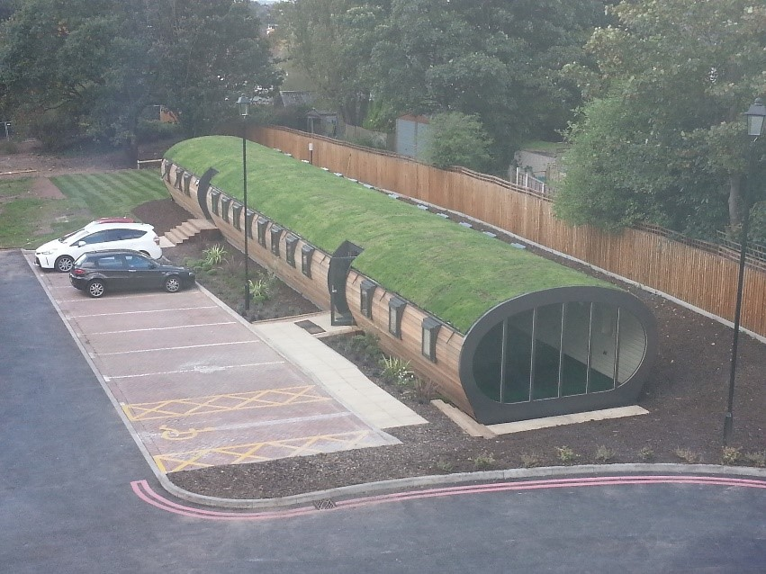
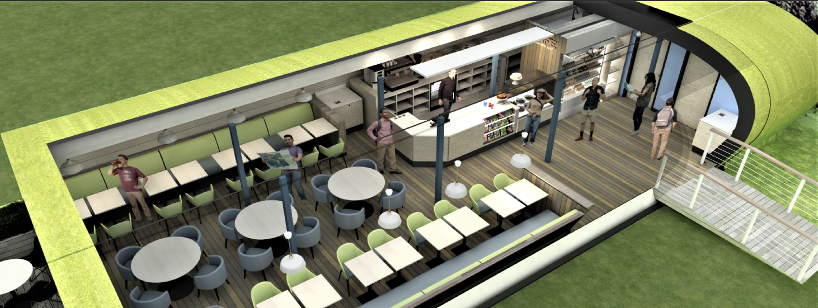
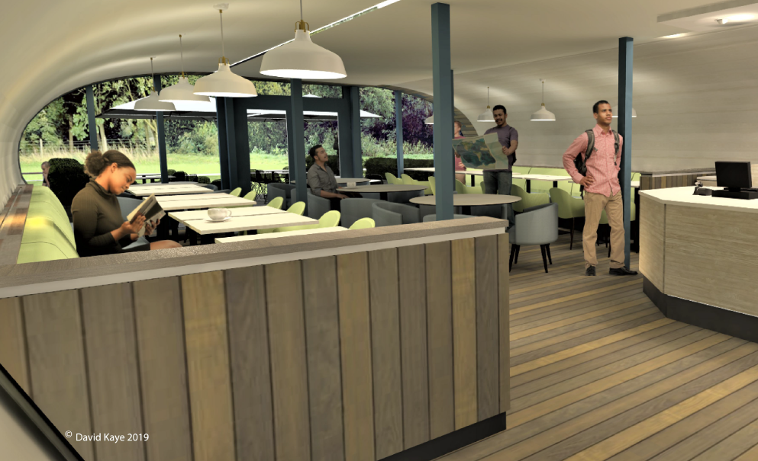
Similar Visitor Centre Buildings

Slide 6
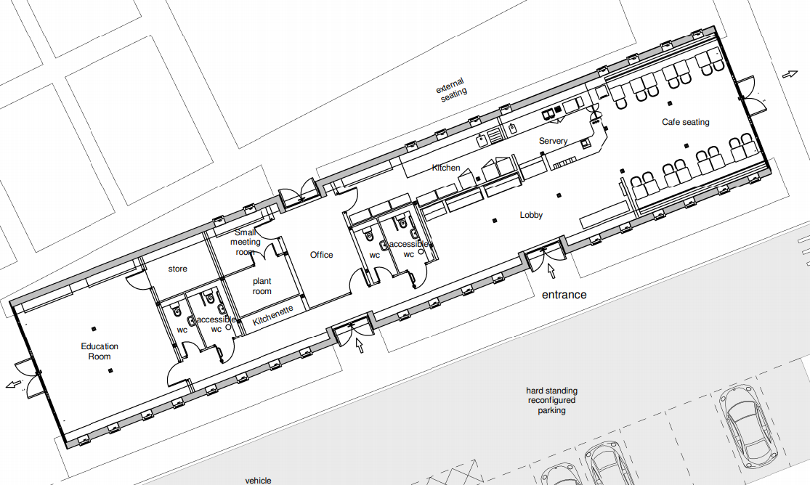
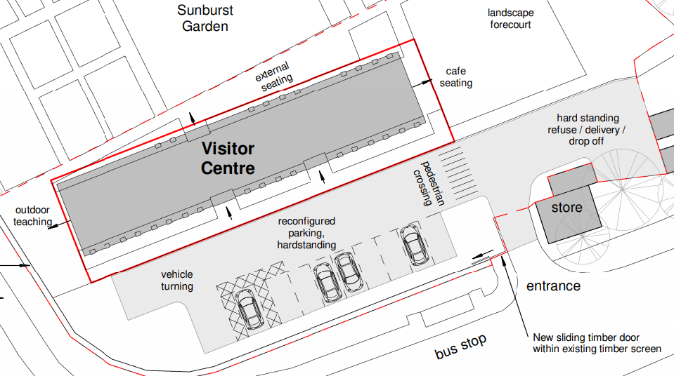
Visitor Centre Planned Location
The new Visitor Centre building will sit at the front of the Grow Wilder site, making it highly accessible to the local community, including Frenchay, Broomhill and Lockleaze.
It will be the natural first touch point for anyone arriving at site and will offer them guidance for how they can proceed into site.
The back of the building will face over the sunburst garden, giving a wonderful vista over the food growing demonstration area.
PENDING APPROVAL
PENDING APPROVAL
*Note, final design may have some differences in doorway locations, floor plan and landscaping.

Slide 7
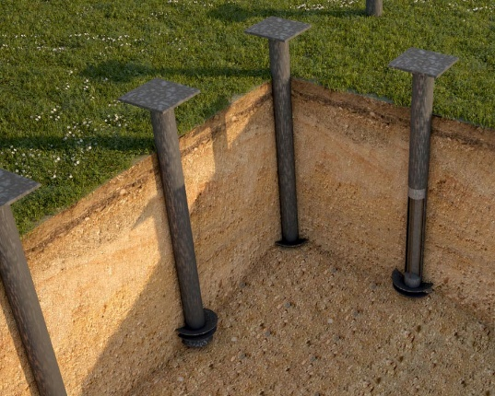
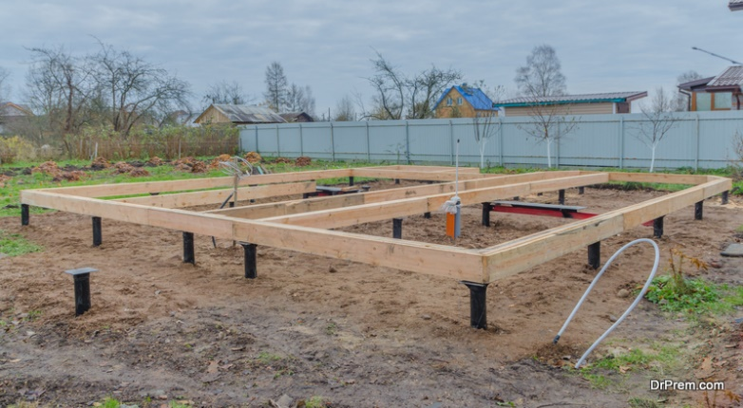
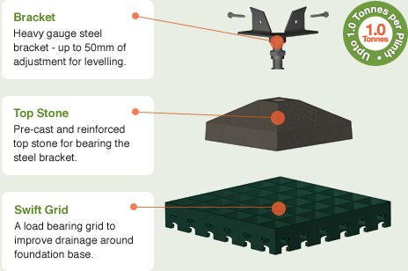
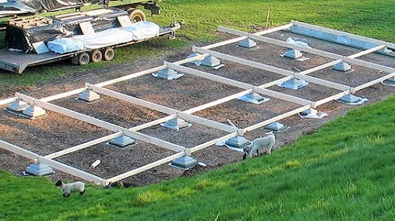
Aiming for Low Impact
Project will be focussed on minimal soil impact
Building Foundations. 2 options being reviewed:
Plinths – Low Impact
84 x Base grid 500 x 500 x 65mm
Screw Piles – Very Low Impact
84 x 60mm screws. Less than 1 square metre of potential soil compaction.
Car Park
Ground currently compacted and covered by gravel. Aim will be to rehabilitate soil. Consider mesh and or grid system to spread weight, with high drainage medium. Fit channel drains to reduce run off.

Slide 8
We Would Be Grateful For Your Comments
Offer your support or feedback by emailing growwilder@avonwildlifetrust.org.uk or by filling in the form at our blog post here.
If you are interested in event, activities or learning opportunities at Grow Wilder, please follow us on Facebook or sign up to the Avon Wildlife Trust mailing list via our website.

